Slide 1
Federal University Of Technology Minna
School of Electrical and Engineering Technology(SEET)
Department of Mechatronics Engineering
Project Title: Smart Irrigation System
Using Sensors and Automation for Efficient Watering
Group 5

Slide 2
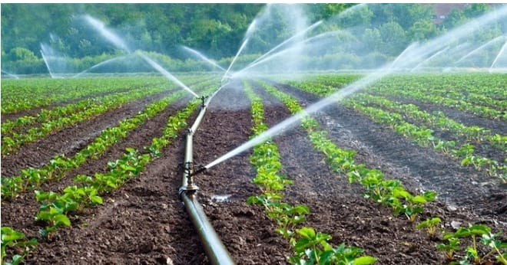
Introduction
For many small-scale farmers, garden owners, and even plant lovers with busy schedules, keeping plants properly watered can be a challenge. Without constant attention, plants may suffer from overwatering or drying out. This Smart Irrigation System solves that problem using automation. It checks the soil’s moisture level and only waters plants when needed. It also monitors the water level in the tank to avoid dry runs. With this system, plants get the right amount of water at the right time — saving time, effort, and water.
Notes:
2

Slide 3
Problem and Solution Overview
Many rural farmers and gardeners rely on guesswork for watering. This often leads to wasted water and poor plant health.
  Our system uses a soil moisture sensor to know when watering is needed.
  A water level sensor checks if there's enough water in the tank.
  A relay-controlled pump turns ON automatically to water the plant.
  This is Ideal for small farms, gardens, home plants, or people with busy lives.

Slide 4
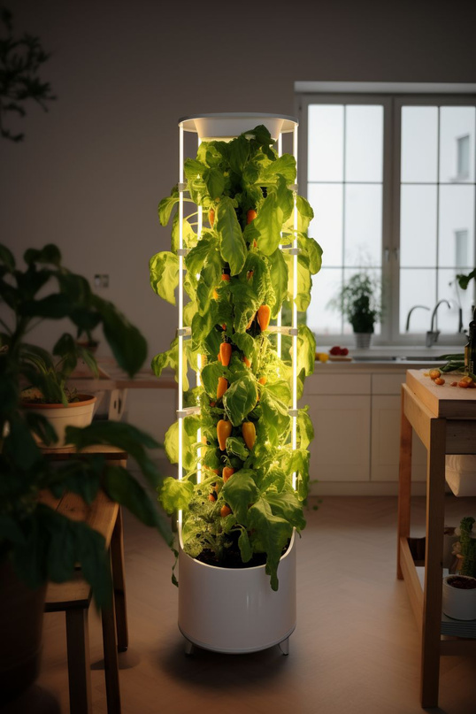
Problem Statement
  Manual watering is time-consuming and inconsistent.
  Busy schedules lead to plant neglect.
  Water wastage is common in manual irrigation.
  There is a need for a low-cost, automatic solution that ensures optimal watering.

Slide 5
Objectives
  To build a system that waters plants only when needed.
  To use sensors and automation for stress-free plant care.
  To create a cost-effective and easy-to-use solution for small-scale users.
  To reduce water waste and improve plant health.

Slide 6
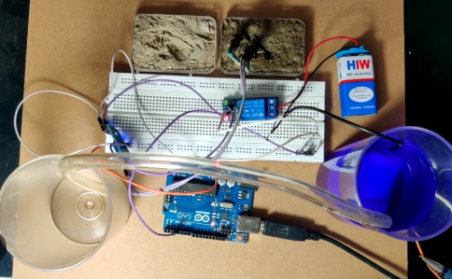
Methodology Overview
The soil moisture sensor is inserted into the soil, near the plant. The Arduino checks if the soil is dry or wet. If the soil is dry, it checks the water tank using a water level sensor. If water is available, the pump turns ON and waters the plant.
Red and Green LEDs show the system status:
  Red = low water level in tank, indicates need to refill tank.
  Green = Indicates water in tank is still much.

Slide 7
How It Works: Step-by-Step
  Insert soil moisture sensor near plant root.
  Arduino checks soil dryness in real-time.
  If dry, it checks if water tank has water.
  If both conditions are met:
  Relay activates pump and waters plant.
  After watering, pump shuts off.
  Red/Green LEDs indicates tank water level for garden owners.

Slide 8
Component List
Component | Function
Arduino Nano | Central controller
Soil Moisture Sensor | Detects soil dryness
Water Level Sensor | Checks tank water level
Relay Module | Switches pump ON/OFF
Mini Submersible Pump | Waters the plant
Red & Green LEDs | Show stank water status
Flexible Hose | Delivers water to plants
Water Container | Holds irrigation water
Jumper Wires | Connections
Breadboard | Circuit assembly
Plastic container | To build casing for plants

Slide 9
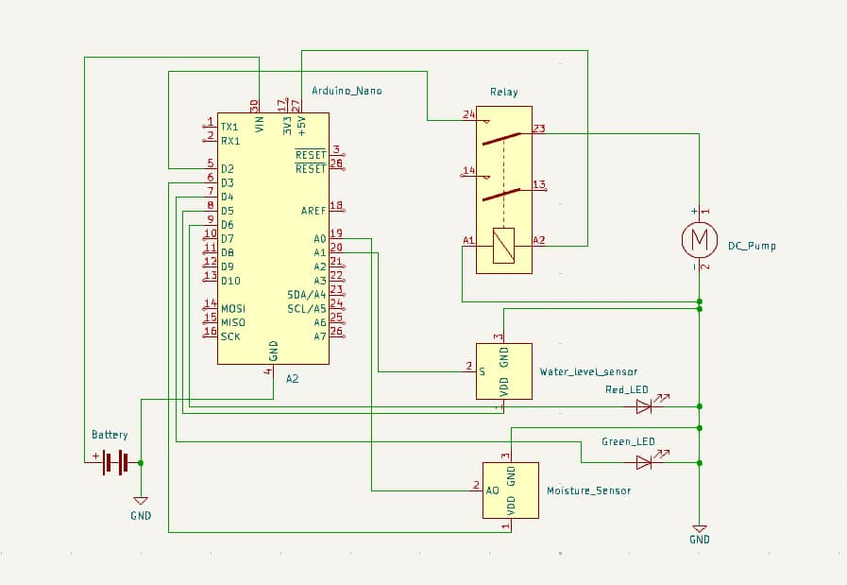
Circuit Diagram

Slide 10
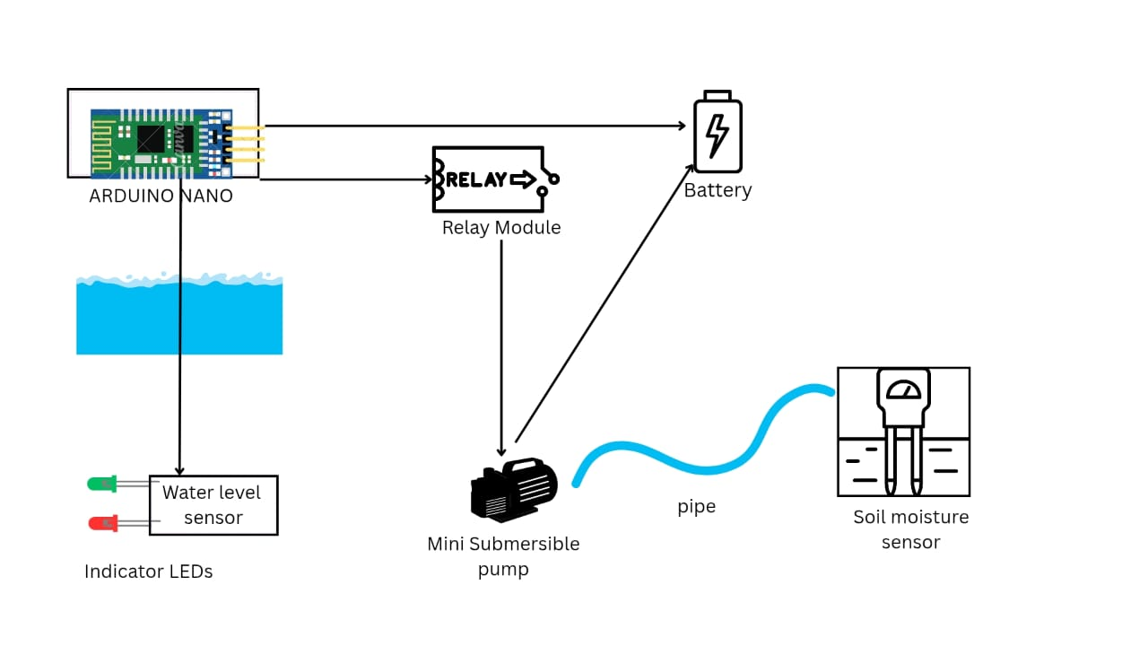
Block Diagram

Slide 11
Why This System is Useful
  Saves time for busy farmers or plant owners
  Easy to set up and use — no technical skills required
  Supports precision watering
  Prevents pump damage from dry runs
  Ideal for home gardens, plant pots, rural farms, school gardens

Slide 12
Conclusion
  Smart farming doesn’t have to be expensive.
  Sensors and automation make watering easier and more accurate.
  Perfect for small farms, home gardens, or anyone with busy routines.
  Your plants get the right care even when you're away.

